Slide 1
Lending Business Context

Slide 2
Module Outline
Objectives
On completing this module, you will:
Understand key considerations related bank lending to retail customers
Understand the principles that underlie credit scoring

Slide 3
Definition of Lending Terms
Current
Customer is up to date with loan payments
Delinquent
Customer is behind on loan payments
In default
Borrower fails to repay a debt
Depends on the terms agreed
E.g. missing X number of payments

Slide 4
Business Problem Context
Lending is the way most banks make money
Key considerations
Net interest rate spread
The difference between
Interest rate received on loans
Interest rate paid on deposits
Simplified example
Lending rate = 4%
Deposit rate = 1%
Net interest rate = 3%
Lending $100b would yield $3 billion in earnings!
Why isn’t it this easy to make money?

Slide 5
Business Problem Context
Key considerations
Loan default rate
Leads to loan losses
Offsets revenue generated made from interest generated from loans
Simplified example
If the average annual default rate is 4%
Losses on a $100b of loans would be $4 billion
Net interest gain of $3b – losses of $4b = net loss of $1 billion!
Also operating expenses and interest paid on deposits not lent
Accordingly, loan interest rates needs to be commensurate with expected risk of default

Slide 6
Types of Loans
Secured lending
Examples
Home mortgage loans
Debt consolidation, home improvement, other…
Auto loans
Assets pledged as collateral
E.g. home equity, automobile equity, jewelry, etc.
Collateral can be liquidated to cover loan exposure in case of default
Lower risk for bank, but requires more effort to
Verify ownership
Value collateral
Monitor collateral

Slide 7
Types of Loans
Secured lending – simplified example
Condo price $1,000,000
Bank lends customer $700,000
Bank requires down payment of $300,000
Home equity collateral = $300,000
If customer defaults on loan
Bank takes possession of property
Sells property $900,000
Keeps $700,000
Passes on remaining $200,000 to customer
What happens if the property sells for $600,000?
The bank loses money on the loan!

Slide 8
Types of Loans
Unsecured lending
Examples
Credit cards – revolving debt
Personal loans
No collateral
Primary leverage with customer is reporting to credit bureau
Higher risk for bank
Lower credit limits than for collateralized lending
Higher interest rates
More collection effort

Slide 9
Types of Loans
Unsecure lending – simplified example
Customer applies for credit and is approved
Year 1 credit limit = $1,000
Year 2 credit limit = $1,500
Based on transaction and repayment history
Customer becomes 30-day delinquent
Bank may suspend further credit and perform collection actions
Customer either
Is ”cured” and becomes current again
Slips to 60, 90, 180 days delinquent
After 180 days, is written off as defaulted “bad” debt
The longer the delinquency, the greater likelihood of default

Slide 10
Business Problem Context
Key determinants of lending profitability
Interest rate charged on loans
Average default rate of the loan portfolio
To minimize losses due to defaults, it is critical to
Assess potential borrowers’ likelihood to default
Lend to those who are better credit risks
Limit the amount of credit provided
Ensure that the interest rate charged on loans reflects the average risk of default for the portfolio

Slide 11
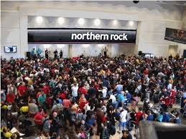
Regulation of Lending
Prudential regulation
Designed to ensure that financial institutions do not fail due to too many bad loans
Require adequate capital buffers to protect against various risk exposures
Bank’s capital is provided by shareholders
Regulatory requirements prevent banks from taking on too much credit risk

Slide 12
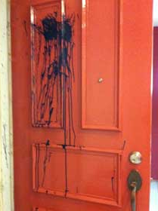


Regulation of Lending
Consumer protection regulations
Prevent unfair or biased lending
Ensure that consumers are not subject to predatory lending
Limit debt collection practices

Slide 13

WooClap
www.wooclap.com/IS453S9CC

Slide 14
Manual Credit Assessment
For many years, credit requests were evaluated manually
Issues
Slow approval
Error prone
Subject to individual biases
Today, manual credit review is mainly limited to
Corporate
High-value
Borderline cases

Slide 15
Credit Assessment
Estimates whether applicant will successfully repay his/her loan based on various information
Applicant characteristics
Credit bureau information
Application information of other applicants
Repayment behavior of other applicants

Slide 16
Judgmental vs. Statistical Assessment
Judgmental
Based on:
Experience of the lender / loan officer
Knowledge of the customer
5 C’s: character, capital, collateral, capacity, condition
Statistical
Based on multivariate correlations between inputs and risk of default
Both assume that the future will resemble the past

Slide 17
Credit Assessment
Develop models (also called ‘scorecards’)
Estimate the probability of default given a customer’s profile
Typically, scorecards
Assign points to ranges for each input variable
The points are then summed
Compared with a threshold (cut-off) defined by the institution

Slide 18
Simplified Scorecard Example
Credit approval scorecard cut-off = 500
Characteristic Name
Attribute
Scorecard Points
120 points
180 points
160 points
Total 460 points
A new customer applies for credit.
Based on the credit scoring model
should she be approved?
AGE 32
GENDER Female
SALARY $1,150
AGE 1
Up to 26
100
AGE 2
26 - 35
120
AGE 3
35 - 37
185
AGE 4
37+
225
GENDER 1
Male
90
GENDER 2
Female
180
SALARY 1
Up to 500
120
SALARY 2
501-1000
140
SALARY 3
1001-1500
160
SALARY 4
1501-2000
200
Deny Credit
SALARY 5
2001+
240
What’s wrong with this scorecard?
Notes:
AGE 32 120 points
GENDER Female 180 points
SALARY $1,150 160 points
Total 460 points – deny credit
What’s wrong with this scorecard? - Discrimination based on gender?!

Slide 19

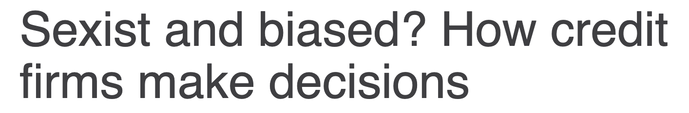

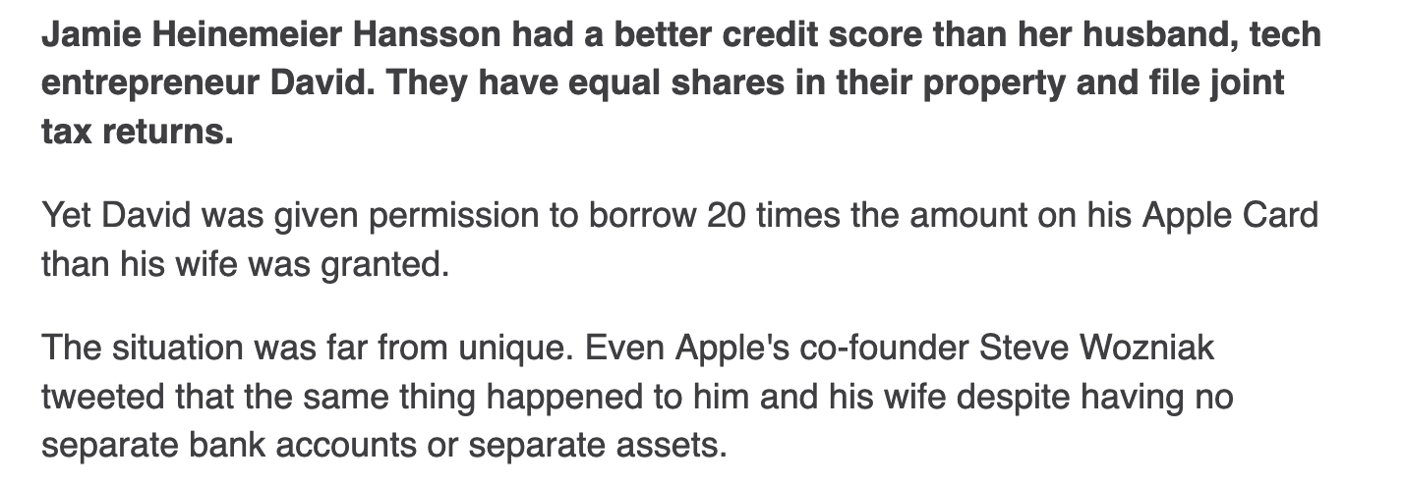
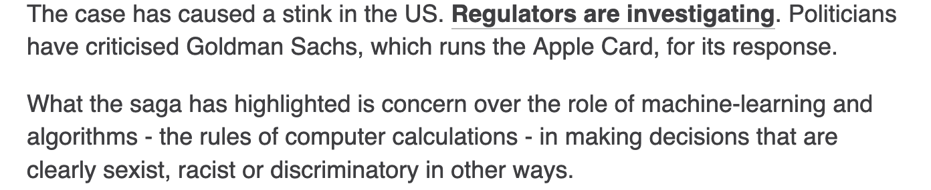
Lending Bias Concerns

Slide 20
Benefits of Developing Credit Scoring Models
Speed and accuracy
Consistency
Lower losses due to customer defaults
Reduced operating costs
Improved portfolio management

Slide 21
Types of Credit Scoring
Covered in this session
Application scoring
Behavioural scoring
Profit scoring
Bankruptcy prediction
Will be discussed in Week 12

Slide 22
Application Scoring
Estimate probability of default at the time the applicant applies for the loan
Use predetermined definition of default
For example, 3 months of payment arrears
Use application variables
Age, income, marital status, years at address, …
Use bureau variables
Bureau score
Raw bureau data, e.g.
number of credit checks
total amount of credits
delinquency history
…
Notes:
Others
Baycorp Advantage (Australia & New Zealand)
Schufa (Germany)
BKR (the Netherlands)
CKP (Belgium)
Dun & Bradstreet (MidCorp, SME)

Slide 23
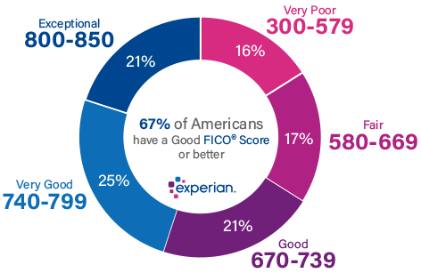
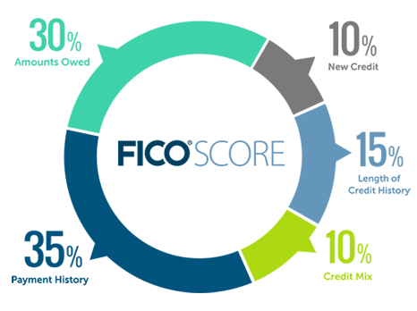
Application Scoring
In the US
Fico scores range between 300 to 850
Main credit bureaus: Experian, Equifax, and TransUnion
Notes:
Others
Baycorp Advantage (Australia & New Zealand)
Schufa (Germany)
BKR (the Netherlands)
CKP (Belgium)
Dun & Bradstreet (MidCorp, SME)

Slide 24
Commonly Used Variables for Credit Assessment
Age Time at residence Time at employment Time in industry First digit of postal code Geographical: Urban/Rural/Regional/Provincial Residential Status Employment status Lifestyle code Existing client (Y/N) Years as client Number of products internally Internal bankruptcy/write-off Number of delinquencies Beacon/Empirical Time at bureau Total Inquiries Time since last Inquiry Inquiries in the last 3/6/12 mths Inquiries in the last 3/6/12 mths as % of total | Income Total Liabilities Total Debt Total Debt service $ Total Debt Service Ratio Gross Debt Service Ratio Revolving Debt/Total Debt Other Bank card Number of other bank cards Total Trades Trades opened in last six months Trades Opened in Last six months / Total Trades Total Inactive Trades Total Revolving trades Total term trades % revolving trades Total term trades Number of trades current | Number of trades R1, R2..R9 % trades R1-R2 % Trades R3 or worse % trades O1..O9 % trades O1-O2 % Trades O3 or worse Total credit lines - revolving Total balance - revolving Total Utilization total balance- all

Slide 25
Further Reading (optional)
Lending context
“Financial Services Technology” book
Chapter 8 – Lending and Debt Collection
Available at the SMU library
Online and hardcopy

